Slide 1

Permutation test
Michelle Gonzalez
MTH410

Slide 2
What is graph Coloring?
It is a special case when it comes to graph labeling.
A proper coloring of a graph is an assignment of colors to the vertices of the graph so that no two adjacent vertices have the same color.

Slide 3
1
5
1
5
2
4
2
4
3
3

Slide 4
What Coloring Represents?
Graphs are used to depict ”what conflicts with what”, and colors are used to denote the state of a vertex. So, more precisely, coloring theory is the theory of “partitioning the sets having internal irreconcilable conflicts” because we will only count “good” colorings.

Slide 5
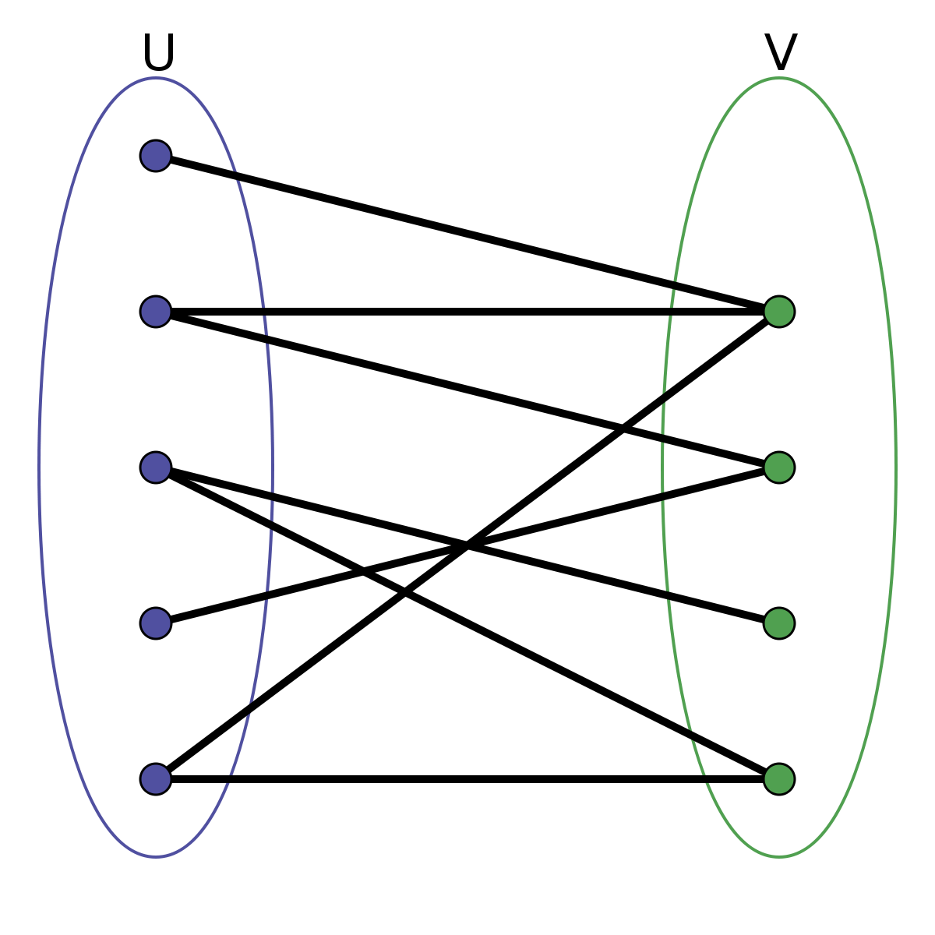
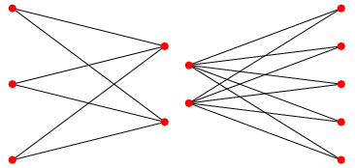
Two Color Graphs and Bipartite
A Bipartite Graph also called a bi-graph, is a set of graph vertices, points where multiple lines meet, decomposed into two disjoint sets, meaning they have no element in common, such that no two graph vertices within the same set are adjacent.

Slide 6
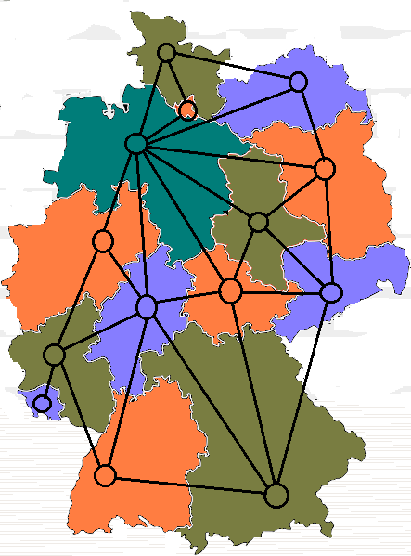
Fr
Francis Guthrie

Slide 7
History of The Four Color Theorem
When mentioning about coloring the countries on a map, If we denote the countries by points in the plane and connect each pair of points that correspond to countries with a common border by a curve, we obtain a planar graph.

Slide 8
What They Were Trying to Prove
The Four Color Theorem became one of the most difficult problems in Graph Theory, besides colorings it stimulated many other areas of graph theory. Generally, coloring theory is the theory about conflicts: adjacent vertices in a graph must always have distinct colors; they are in a permanent conflict. As mentioned previously, if we have a “good” coloring, then we respect all the conflicts.

Slide 9
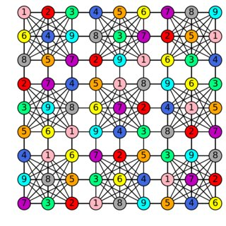

Slide 10
In conclusion, graph coloring is a special case of graph labeling. My goal was to further explore graph properties and vertex colorings and also to know great history of graph coloring four color theorem and two color theorem, what they were trying to prove, applications of coloring and coding algorithms to demonstrate this case through C++ code.

